Slide 1
CptS 327
Web Privacy
Notes:
Template-WSU Hrz 201.ppt

Slide 2
Today’s Topics
Overview
  Cookies and their impact on privacy
  HTTPS Side-channel attacks
  Improving Privacy
Notes:
Template-WSU Hrz 201.ppt

Slide 3
Cookies
A temporary structure to store web data items
Revolutionized the web
  Turned web ecosystem from stateless to stateful
  Good for authentication
  Bad for privacy
Example
  SID=DQAAAK…Eaem_vYg; Domain=example.com; Path=/index.html; Expires=Wed, 13 Jan 2021 22:23:01 GMT; Secure; HttpOnly
A typical cookie has: SID, domain, path, expiration, and flags
  The example has two flags
    Secure – only send over HTTPS
    HttpOnly – accessbile only by HTTP/S (not scripts or style sheets)
Notes:
Template-WSU Hrz 201.ppt

Slide 4
Cookies
Helps authentication by enabling setting of permissions for users on a website
A user doesn’t have to log in every time they visit a website
Undermines privacy because websites abuse cookies to store user preferences
The user preference data can be used for potentially unsolicited ads
Example:
  User A visits sales.com, purchases product P
  User A visits search.com to search for something unrelated
  But user A sees an ad related to product P from sales.com on search.com
Notes:
Template-WSU Hrz 201.ppt

Slide 5
Cookies
Cookies can enable web profiling of a user
Web profiling:
  Traffic monitoring
  Service monitoring
  Temporal monitoring
  Content monitoring
Example – Firefox Lightbeam
Notes:
Template-WSU Hrz 201.ppt

Slide 6
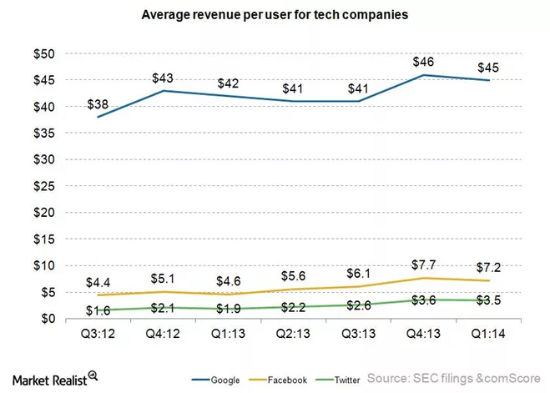
How do companies use user web profile data?
Notes:
Template-WSU Hrz 201.ppt

Slide 7
EverCookies
EverCookies are seemingly persistent cookies
  Javascript API
  Cookies automatically repopulate even if you delete them
  Done by copying cookie content into all available data stores
  Scripts are used to enable the auto repop
EverCookies started out to enable data storage for web browsers
  User data
  Database items
  Media content
Example: https://samy.pl/evercookie/
Notes:
Template-WSU Hrz 201.ppt

Slide 8
HSTS SuperCookies
HSTS: HTTPS Strict Transport Security
Used to prevent web browsers from accidentally using a HTTP version of a site
  HSTS SuperCookies store a command to force browsers
Security analysts found out that a host issuing HSTS SuperCookies can be compromised and made to leak a user’s web profile
  All users of the host are vulnerable
https://nakedsecurity.sophos.com/2015/02/02/anatomy-of-a-browser-dilemma-how-hsts-supercookies-make-you-choose-between-privacy-or-security/
Notes:
Template-WSU Hrz 201.ppt

Slide 9
PanoptoClick
Cookies aren’t the only privacy menace
Many programs enable unique identification of users
Webservers can make your browser execute all sorts of scripts and media content to determine your web profile
Example
  PanoptiClick: https://panopticlick.eff.org/
The user agent string from each browser
The HTTP ACCEPT headers sent by the browser
Screen resolution and color depth
The Timezone your system is set to
The browser extensions/plugins, like Quicktime, Flash, Java or Acrobat, that are installed in the browser, and the versions of those plugins
The fonts installed on the computer, as reported by Flash or Java.
Whether your browser executes JavaScript scripts
Yes/no information saying whether the browser accepts various kinds of cookies and "super cookies"
A hash of the image generated by canvas fingerprinting
A hash of the image generated by WebGL fingerprinting
Yes/no whether your browser is sending the Do Not Track header
Your system platform (e.g. Win32, Linux x86)
Your system language (e.g. en-US)
Your browser's touchscreen support
Notes:
Template-WSU Hrz 201.ppt

Slide 10
Enhancing Privacy for Web Browsers
Privacy Enhancing Technologies (PET)
  Browser plugins
    uBlock Origin, Privacy Badger, Ghostery, etc.
  Disable third-party cookies
    Configuration option in most modern web browsers
    Can break some functionality (i.e. ads and trackers)
  Tor browser
  Tails OS (https://tails.boum.org)
    Live OS focusing on privacy
    Each boot ends a session with shutdown
    Some user-allowed persistent data from one session to another
    Configured to use Tor and other encryption tools
Notes:
Template-WSU Hrz 201.ppt

Slide 11
Enhancing Privacy for Web Browsers
Privacy Enhancing Technologies (PET)
  ‘Do Not Track’ (DNT) configuration setting
    Supported by most modern web browsers
    HTTP Header field values
      1: don’t track
      0: track
      Null: no preference
    Problems
      Not satisfactorily defined
      No incentives or regulation ensuring sites implement your DNT
Notes:
Template-WSU Hrz 201.ppt

Slide 12
HTTPS Side Channel Leaks
Side Channel leaks extract information from attributes of encrypted traffic
  No decryption required
  Leverages known properties about webpage objects and content
  Focuses on enumerating low entropy data
  Focuses on data packets with higher density
  Works for TLS and WPA2
    Padding doesn’t protect completely
  First disclosed in 2010 by Chen et. al.
  http://research.microsoft.com/apps/pubs/default.aspx?id=119060
Notes:
Template-WSU Hrz 201.ppt

Slide 13
HTTPS Side Channel Leaks
Encrypted traffic from each website produces a similar encryption pattern
  Encryption pattern stays same for specific content types
    E.g.: ‘8e%axCf9z…’ is a TLS encryption snippet for images
  From the captured encrypted data, we can determine
    Which website the data originated from
    What type of content is in the data
    What characters are in the data (especially for search engine queries)
Notes:
Template-WSU Hrz 201.ppt

Slide 14
HTTPS Side Channel Leaks
Flow vectors
  Encrypted data regarding user navigation on a webpage
  Reveals info such as
    Which tabs/buttons of the website were clicked by the user
    Did a user select a condition?
    Did a user select an option?
    What settings does the user have on a webpage?
  E.g.: 515±1➔, 266±1➔,⬅583±1, ⬅x
    The above flow vector lets us know that:
      A user visited their health records on their healthcare provider’s website
      A user clicked on ‘Conditions’ tab and clicked on ‘Add’ button
      A user selected an option out of ‘conditions’ dropdown menu
Notes:
Template-WSU Hrz 201.ppt

Slide 15
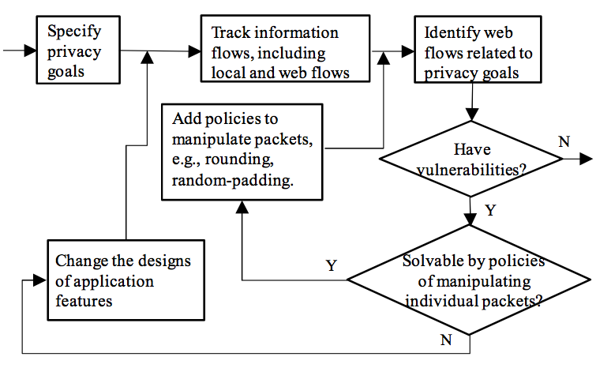
Improving Privacy
Notes:
Template-WSU Hrz 201.ppt

Slide 16
Next lecture
Going back to cryptography
  Crypto history
Notes:
Template-WSU Hrz 201.ppt

Slide 17
Any questions?
Notes:
Template-WSU Hrz 201.ppt

